Slide 1
Observing World Food Safety Day 7th June, 2021
Department of Anthropology
4th Semester (Honours)
Narasinha Dutt College, Howrah

Slide 2
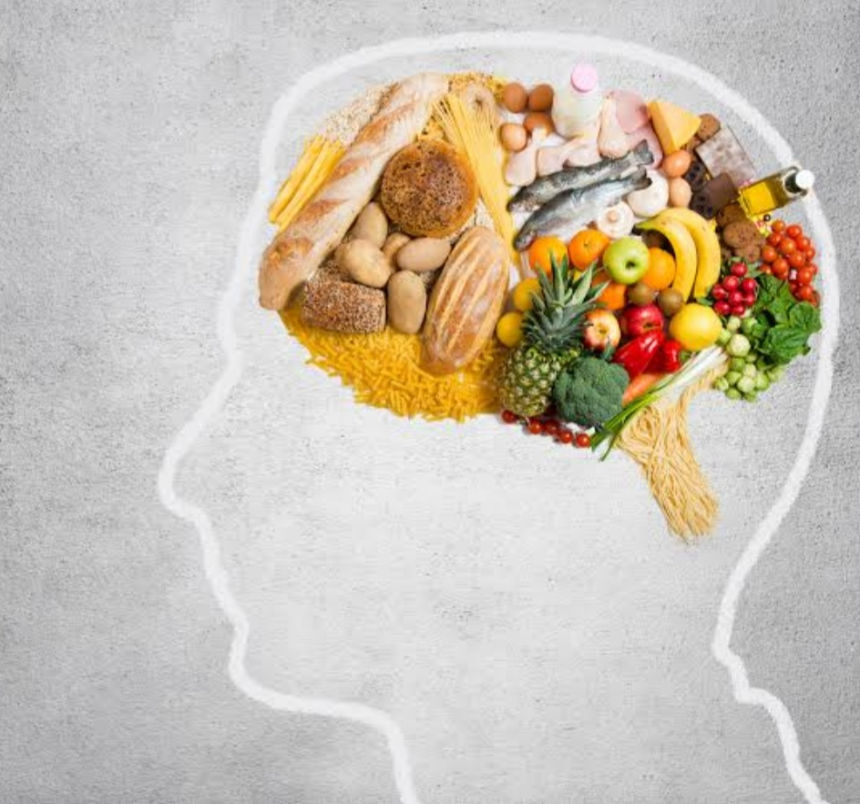
Food
Any substance that people or animals eat or drink or that plants absorb in order to maintain life and growth is called food.
As food is an integral part of our social existence, this function is important in daily life.

Slide 3
Food In Anthropology
Anthropology of food can be defined as “the set of representation, beliefs, knowledge and practices inherited or learned that are associated with food and shared by individuals of a certain culture or social group”. (Sobreira et al. 2018)
Apart from the definition it refers to technological and social structures, starting from harvesting food, going through the transformation, up to the kitchen with the intention of meeting food needs.
The concept of a food system has been used by different Anthropologists of many anthropological currents, sometimes being analysed in a simplified way.
“Mankind mastered the natural processes, using them for their own benefit”, food systems are envisioned as symbolic systems and relation between subject and nature.

Slide 4
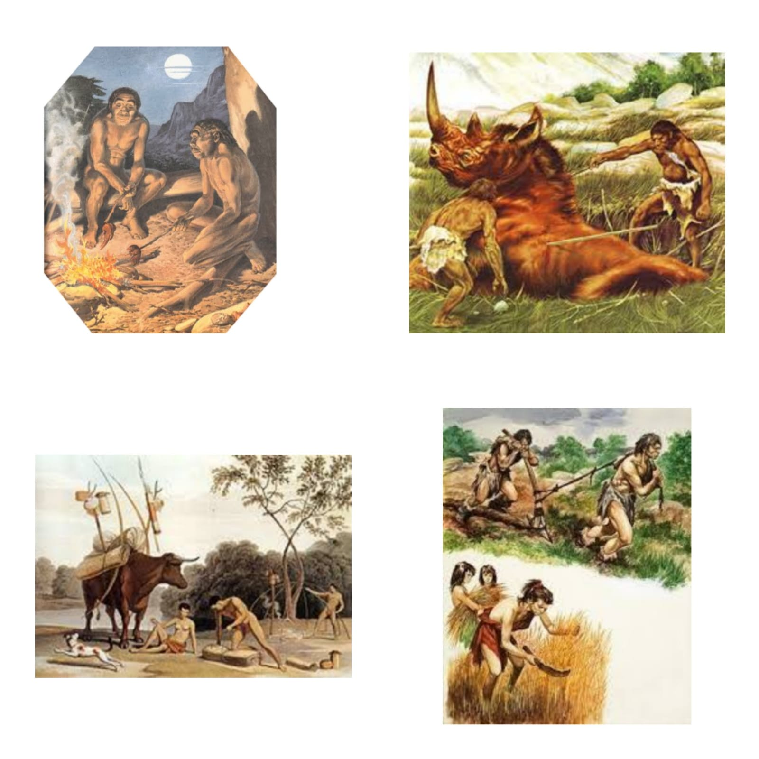
Food Evolution
Hunting & Gathering :- Hunters and gatherers mainly depends on flesh of wild animals, fishes, wild fruits, berries, nuts, etc… to support their diet.
Pastoralism :- Pastoralists rely on their livestock for foods, such as meat, milk, blood, etc… They mainly produce food from the animal milk.
Horticulture :- Horticulturists draw their diets from their gardens, domesticated animals and limited foraging.
Agriculture :- The people of the agriculture society mainly eat cooked food. They depends on domesticated plants such as vegetables and domesticated animals such as cattle, pig, chickens, etc…

Slide 5
Biological Aspect Of Food
Food is usually of plant, animal or fungal origin and contains essential nutrients, such as Carbohydrates, Fats, Proteins, Vitamins, Minerals and Water. It provide nutritional support of the living organism.
Nutrients are compounds of foods essential to life and health, providing us with energy, the building blocks for repair and growth.
Those nutrients can be divided into two categories: Macronutrients(carbohydrate , proteins & fats) & Micronutrients.(vitamins & minerals)
There are six major nutrients which a human body need-
Protein :- Meat, Dairy products, etc…
Carbohydrates :- Rice, Breads, Fruits, etc…
Vitamin :- Fruits & Vegetables (Vitamin- A,C); Grains (Vitamin- B); Egg yolk (Vitamin- A,D,E); Milk & Soya bean (Vitamin- K), etc…
Lipid (most commonly known as Fat) :- Butter, Nuts, Oils, etc…
Minerals :- Red meat, Seafood, Vegetables, etc…
Water
Smart nutrition and food choices can help to prevent disease.

Slide 6
Social Aspect Of Food
Food is an essential and fundamental part of culture in human society in its physiological and cultural compliance.
It always been a central part of our social existence, our community and our social, cultural and religious life.
Food is an object of analysis just like other cultural aspects of studies society, such as kinship. Food is vehicle for expressing friendship, for smoothing social intercourse.
It is a phenomenon that covers social, political, economic and aesthetic aspect.
Rituals and celebrations are usually centred around food. Sometimes the type of food served can define the event.

Slide 7
Food Variation
We can see the variation of food by globally as well as our country “India”.

Slide 8
Geo Climatic Food Variation
Arctic Region :-
Diet generally contains of animal protein.
Summers offered limited vegetation, such as cloudberries.
Traditional Inuit fruit foods include seal, polar bear and caribou- consumed raw, frozen or dried.
Desert Region :-
People favours low protein cereal grains, local varieties of vegetation, teas and coffee.
High level of protein are not desirable.
San Bushman of Kalahari are a hunter-gatherer people who have survived for 20,000 years by primarily hunting wild game and gathering nuts and berries
Tropical Region :-
People depends on a diet heavy on fruits and seasonal crops and veggies.
Diverse food variations found depending on several socio-economic and religious aspects from region.

Slide 9
Regional Food Variation in India
Northern India :-
Arid, less humid climate.
Specific ingredients are wheat, rice, saffron, maize, turmeric.
Diverse food culture reflects many waves from Mongolia, Persia, Turkey.
Western Region :-
Lies in largely dry stretches of dessert.
Jains practice vegetarian diet, where as Rajputs are avid hunters diet consisted of mutton with wide variety of chutneys.
Eastern & North-Eastern Region :-
No shortage of green veggies, fruits and rice.
Sweets are famous in Bengal like Rosogolla, Rasmalai, Payesh.
Heavy influence of Mongolian and Chines tradition with momos and mutton in every corner of north east.
Aromatic herbs are used.
Southern India :-
Lentils, dried chilies, coconut, tamarind, ginger grow easily on tropical climate.
Spices are used so generously here.
Central India :-
Hot and dry climate region.
Food found with somewhat heavy on spices with a mix of sweet, sour, salty, spicy all at once.

Slide 10
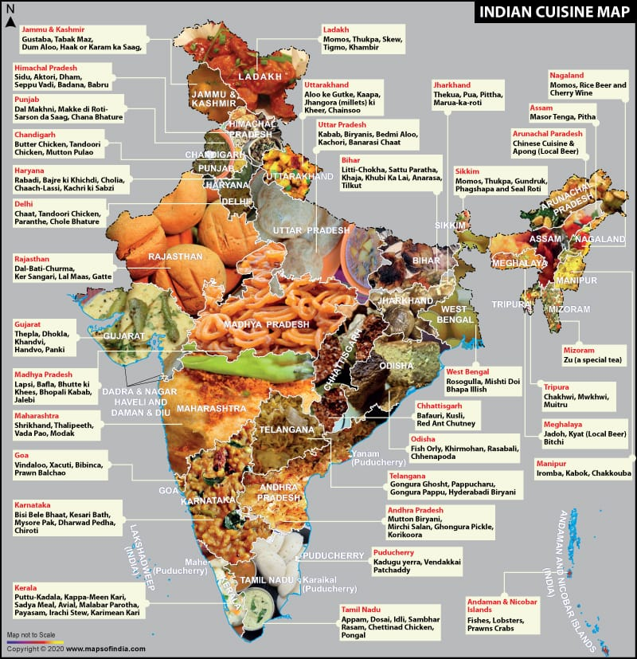

Slide 11
Food Beliefs & Rituals

Slide 12
Food Safety
It is a scientific discipline describing handling , preparation and storage of food in way that can prevent food borne illness . This include a number of routine that should be followed to avoid potentially severe health hazard .
Food safety consideration include the origin of food including practices relating to :
Food labelling
Food hygiene
Food additives
Pesticide residues

Slide 13
Food Spoilage & Preservation
Spoilage commences in food as soon as it is harvested , taken from the sea or slaughtered.
Preservation is the treatment at food to prevent or delay spoilage and destroy or inhibit the growth of pathogenic organism.
Ways to preserving foods:
Dehydration
Vacuum packing
Chemicals etc…

Slide 14
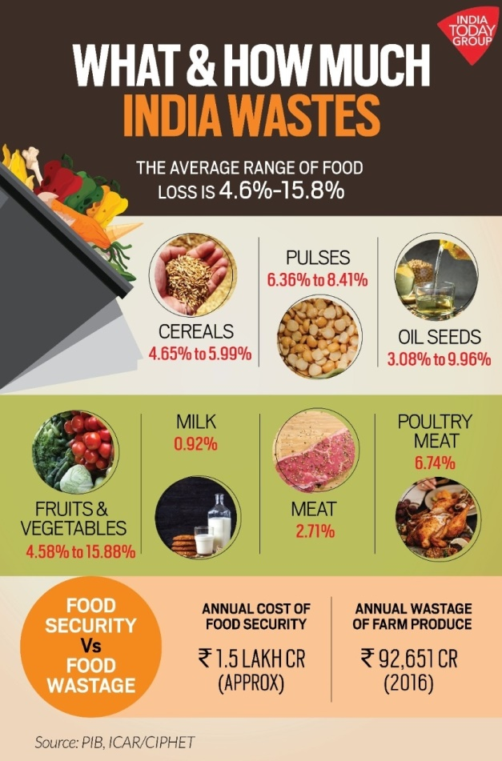
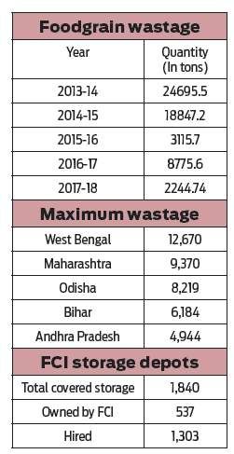
Wastage of Food

Slide 15
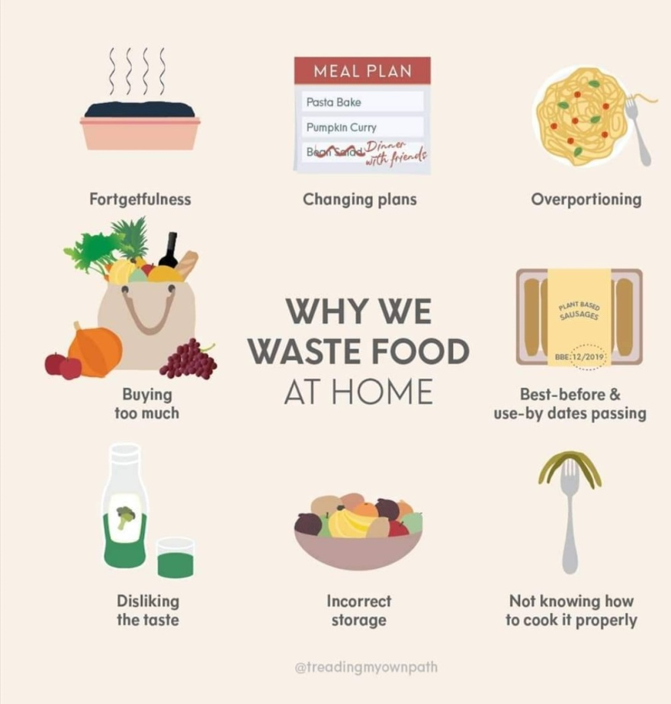

Slide 16
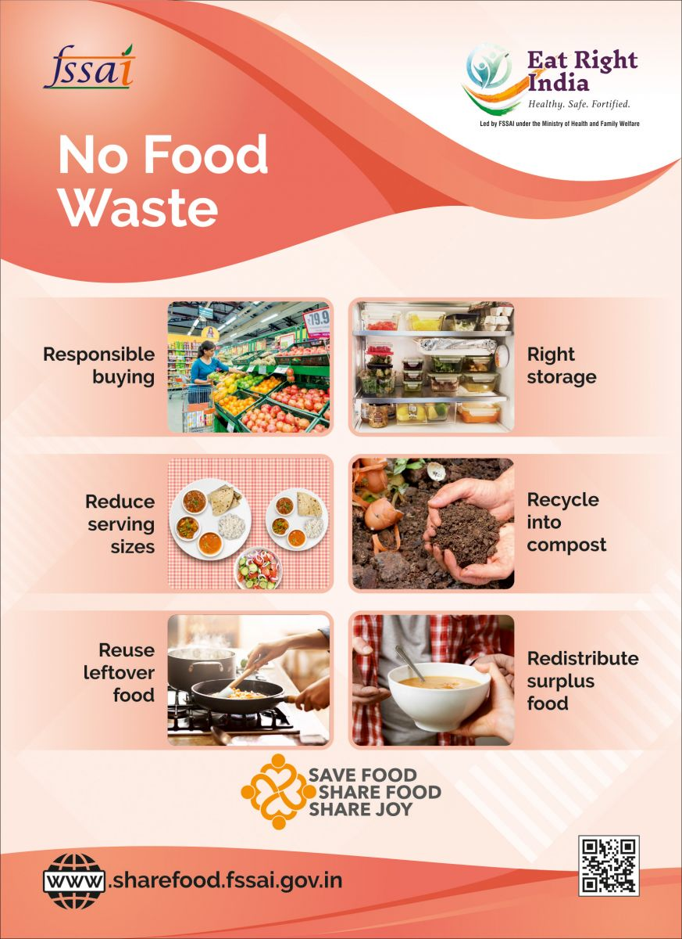
Prevention Of Food

Slide 17
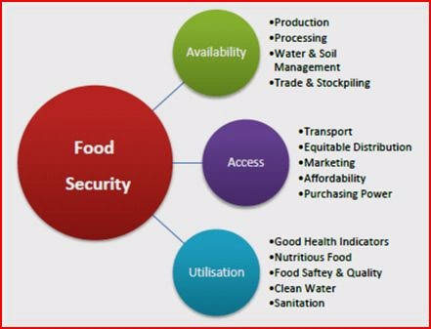
Food Security
According to the committee on World Food Security defined all people at all times, have physical social and economic access to sufficient , safe and nutritious food that meets their dietary needs and food preferences for an active and healthy life .
Food security is often a priority international policy activity.
It’s objectives like improved production and productivity crops and livestock as well as increased economic opportunities for the youth and women.
Food security is access to healthy food and optional nutrition for all.
It could be exemplified like as soup kitchen, food bands, school lunch program, etc… that given food to people in need without requiring any type of commitment in return.
Pillars of foods security are availability access, utilization and stability.

Slide 18
Food Insecurity

Slide 19
Food Scheme
Recently the Union Minister of Food Processing Industries virtually inaugurated the Indus Best Mega Food Park at Raipur , Chhattisgarh.
It is built under the MEGA FOOD PARK SCHEME . By this food park about 5000 people will get employment and 25000 farmers will be benefited.

Slide 20
Conclusion
Food is one of the most basic necessities of a living being . Though it is an important indicator of social differentiation, which defines the boundaries between social groups and hierarchy but still it also brings people of different regions together. It has also a great biological importance in a human body. A wide variety of scientific techniques have been developed to protect consumers and to screen for adulteration in food. Food waste has serious social and environmental implications . But many of us don’t think twice about it. Our hope is that after learning more about this problem, you will do what you can to make a difference.

Slide 21
Thank You.
Supervisors – Prof. Mir Azad Kalam
Prof. Amalesh Kanrar
Made by – Ananya Sardar
Biswarupa Gupta
Sagarika Das
Rounak Show
Moinak Ghosh

